Slide 1
GWPHB@IU
Information Meeting
November 16, 2011
Notes:
Give a welcome. Say the full name, Global Water and Public Health Brigades. Introduce yourself and Collin. Remind them that this is an informational introduction and to be sure to write down any questions that they may have so we can discuss them later

Slide 2
ABOUT US
Mission Statement: Empowering students to empower communities
Global Brigades
National 501c3 Development Organization
USA and international Staff
Global Brigades at Indiana University
Blanket Organization on Campus
Includes Water, Public Health, Microfinance, Business, Environmental, and Medical Brigades
Global Water and Public Health Brigades at IU
Two disciplines working together

Slide 3
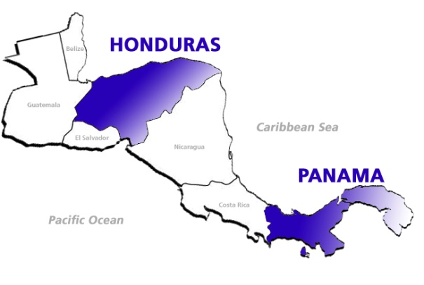
Why Honduras?
70% do not have access to public sanitary services
Average family income is less than $1 a day
Typically no doctors within a 20 mile radius
Typical families have less than 3 gallons of water per day to use

Slide 4
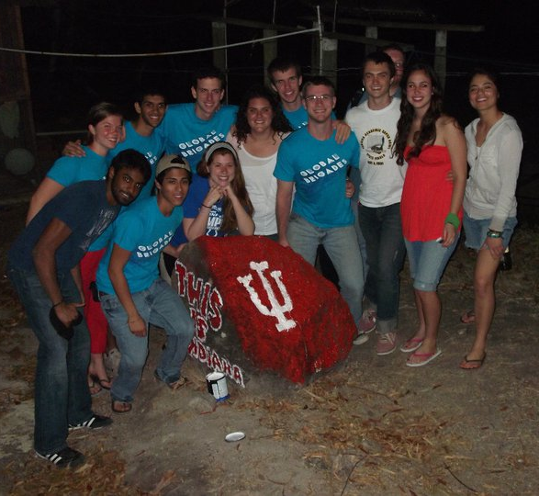
What do we do?
Off-Campus Work Abroad
Brigades in order to do hands-on work and education in communities
Work with GB Staff and community members under direction of in-country staff
On-Campus Work
Donation Drives
Fundraising
Awareness
Collaborations with other student groups
Discussions about development
Future Possibility: Research and distance project development for specific initiatives

Slide 5
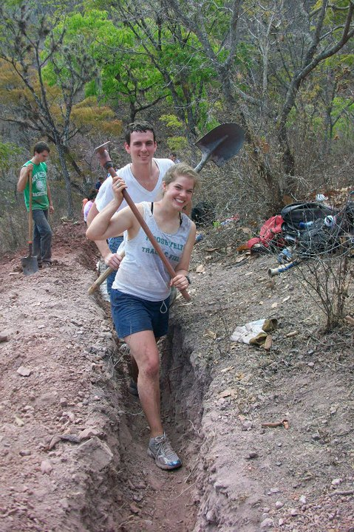
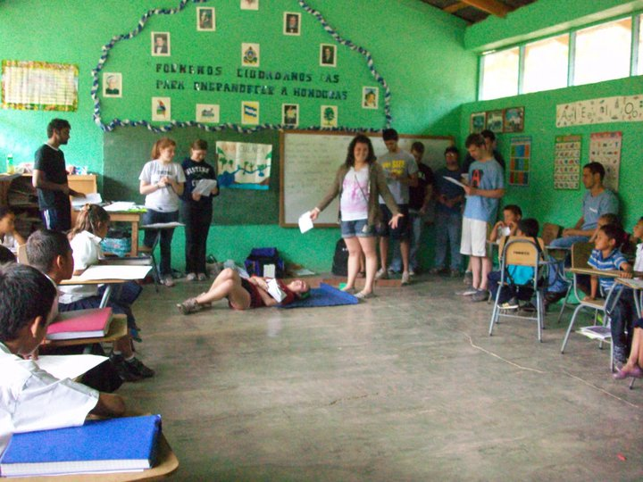
Water Brigade
What a Water Brigade Looks Like:
Travel and introductions
Meet the community, learn about the community specific needs, explore the water system, discussions
Work and Education
Finish and Reflect
Practical Goal: to implement practical and effective water systems and education on proper water-handling practices in order to prevent water-borne illness in the community
Some Benefits: greatly improved health, greater productivity, more time, independence.
El agua es vida

Slide 6
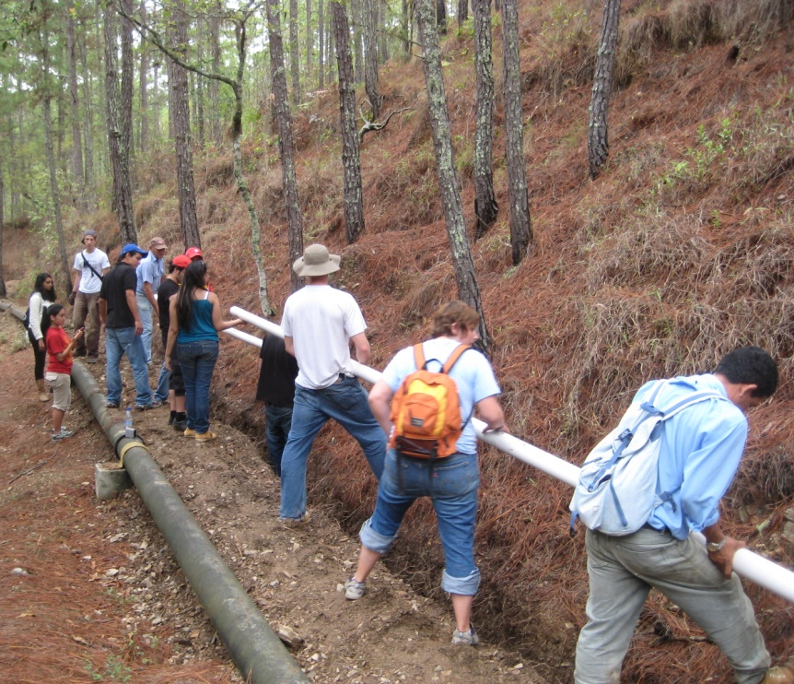
EXAMPLE WATER PROJECT
Community of El Zurzular
After 5 brigades visited the community, a full water system was completed in 2009!
Successful Implementations:
Filter & conduction line
Repaired storage tank & chlorinator
Distribution network
Home Connections
Impact:
All 87 homes in the community are connected to the water system
The flow rate into the storage tank was increased by 233%
Diarrhea cases have significantly reduced in young children
ABOUT
LOCATION
BRIGADE
FOLLOW-UP
LODGING
DONATION
JOIN

Slide 7
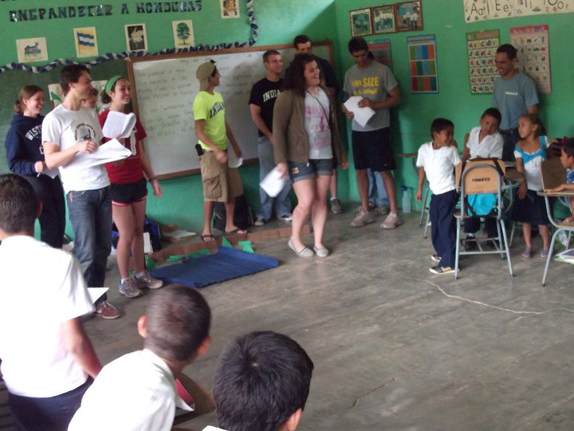
Education & Orphanage
Volunteers conduct educational workshops to adults and children
Promote basic sanitation and hygiene practices
Disease prevention

Slide 8
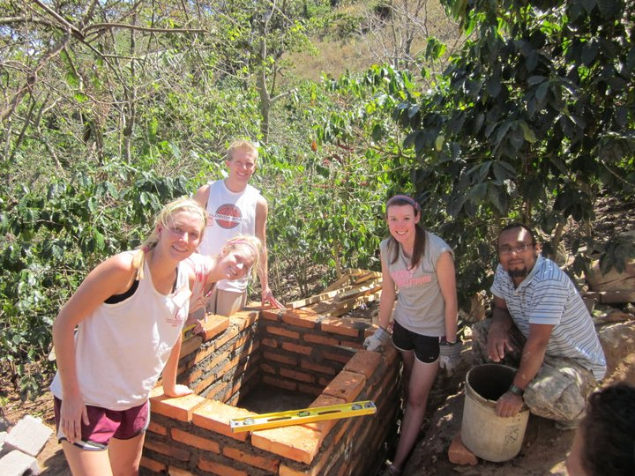
: empowers under resourced communities in the developing world to decrease life threatening diseases by improving home infrastructure and providing public health education
Four projects
Eco-stove
Pilla (water storage)
Latrine
Concrete floors
SIMPLE, YET VITAL!

Slide 9
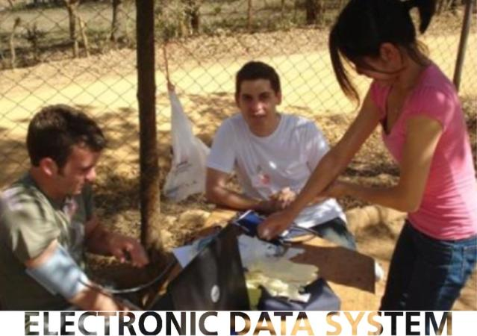
PUBLIC HEALTH BRIGADES
Most brigades include construction of each of the following
four public health projects: concrete floors, water pilas, latrines, and ecostoves.
Global Brigades recently incorporated the use of OpenMRS into its practices. During our Medical Brigades, volunteers store patient information to track community health trends. This information allows Public Health Brigades to track the impact of their construction on community health.
ABOUT
LOCATION
BRIGADE
FOLLOW-UP
LODGING
DONATION
JOIN

Slide 10
ONE WEEK BRIGADE
Eco-stoves with chimneys limit the carbon and smoke that fills the home with harmful smoke and pollutants that cause many of the family’s respiratory illnesses. The eco-stoves also burn much more efficiently, limiting deforestation.
ABOUT
LOCATION
BRIGADE
FOLLOW-UP
LODGING
DONATION
JOIN
eco-stoves
latrines
water storage
concrete floors
education

Slide 11
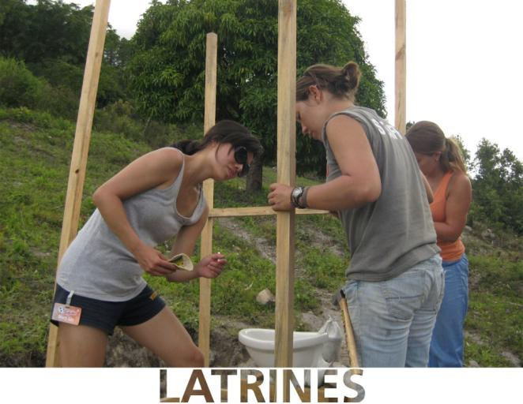
ONE WEEK BRIGADE
Many preventive diseases are caused by unsanitary and unorganized waste disposal. Latrines provide a convenient and inexpensive solution near the home.
ABOUT
LOCATION
BRIGADE
FOLLOW-UP
LODGING
DONATION
JOIN
eco-stoves
latrines
water storage
concrete floors
education

Slide 12
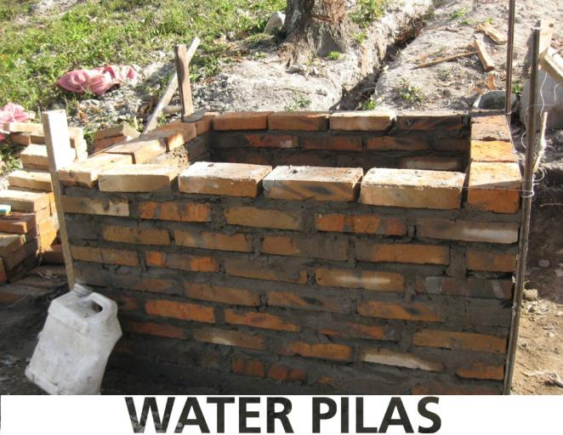
ONE WEEK BRIGADE
Often homes in rural villages do not have a clean and secure place to store water. Water “pilas” allow for a convenient and sanitary storage unit saving families hundreds of hours per year walking long distances to a water source.
ABOUT
LOCATION
BRIGADE
FOLLOW-UP
LODGING
DONATION
JOIN
eco-stoves
latrines
water storage
concrete floors
education

Slide 13
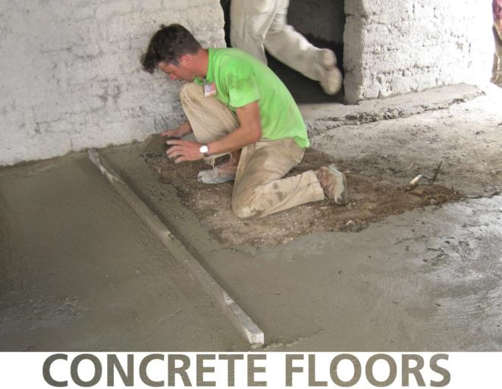
ONE WEEK BRIGADE
Many pathogens and illnesses, including Chagas disease, can easily be prevented by the installation of concrete floors.
ABOUT
LOCATION
BRIGADE
FOLLOW-UP
LODGING
DONATION
JOIN
eco-stoves
latrines
water storage
concrete floors
education

Slide 14
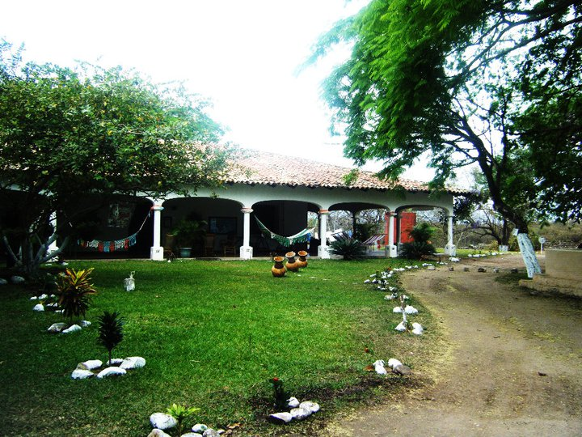
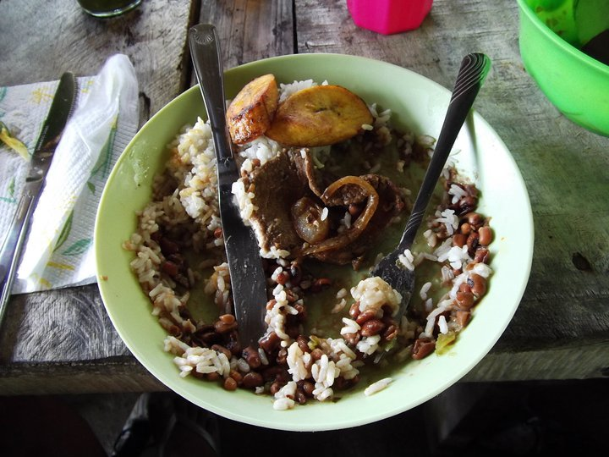
Logistics and Practical Matters
Program contribution Honduras: $750 + Airfare
7 day program
Accommodations and meals (vegetarian options available)
Clean drinking water
Airport pick-up & drop-off
Transportation to and from community
Spanish translators and coordinators
Program sustainability & follow-up between brigades
Project materials $100
Accommodations:
Food:
Safe development is sustainable development!!
Only a positive attitude and willingness to work is required!!

Slide 15
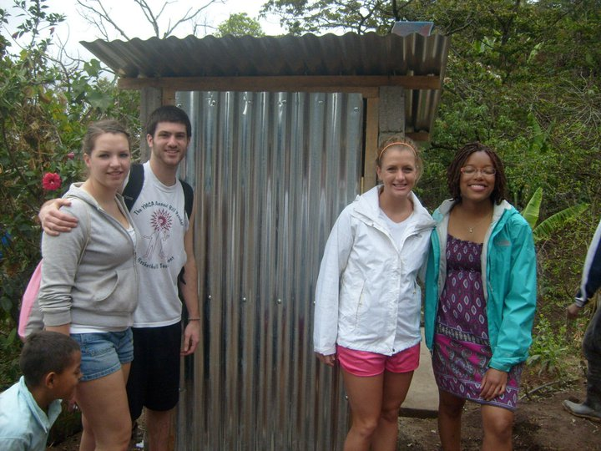
Fundraising
Letter Writing
Write to family and friends
Template available
Canning
Weekend opportunities
Coffee Fundrasier
Earn $5 for each bag sold
Other
Create your own way to fundraise!
**Emails will be sent regarding these fundraising opportunities

Slide 16
Take the Next Steps!!
Get all of your questions answered:
Adam Richter: indiana.gwb@globalbrigades.org
Collin Abbott: collin.abbott@globalbrigades.org
Commit to the trip and start preparing
Sign up officially online (directions in email)
Obtain/renew/find your passport
Begin fundraising
3. Submit your deposit
- Initial $250 deposit is due Nov. 30th (please contact Adam or Collin if you have questions or concerns)

Slide 17
Q& A
Q: Who can go?
A: All IU students with all majors and interests!
Q: Do we have to plan our own flights?
A: No, Global Brigades purchases group flights.
Q: Will I need any extra money?
A: Only for souvenirs, extra spending money, and an exit-country fee.
Q: Does this trip count for class credit?
A: No, this is a volunteer trip not affiliated with IU directly.
Q: Is this trip safe?
A: You will always have security within the country and we will be working in rural communities with very low crime. Global Brigades has never had any incidences endangering students.

Slide 18
Q& A
Q: Do I need a passport?
A: Yes, passports typically take up to two months to receive.
Q: Do we need vaccines?
A: None are required by Honduras or Global Brigades, but a few are strongly recommended.
Q: Is there an exact price for our flight?
A: As of right now, no. Flight costs fluctuate and we cannot book the flight until we have an exact number of volunteers committed. Last year the flight cost $825 and we will try our best to ensure that we get the least expensive flight this year.
Q: Is there an application?
A: There is a form to first fill out but this is purely to get to know you better. No competitive application is required.

Slide 19
Q& A
Q: How many people usually go on the brigade?
A: Last year 34 students went on the Global Water and Public Health Brigade at IU.
Q: How many people do we serve on the brigade?
A: The Water Brigade joins other schools to build a water system for an entire community while the Public Health Brigade works within 2-3 homes, helping 2-3 families.
Q: How does the payment process work?
A: There are typically three deadlines. You can deposit money at any time into your empowered account but there is a $250 minimum due on Nov. 30th, $550 due in Dec./ Jan., and the total is due 2-3 weeks before the brigade.
MORE Q&As
http://globalbrigades.wikidot.com/gwb:faqs
http://globalbrigades.wikidot.com/phb:about

Slide 20
Questions?

